Slide 1

ACCOUNTING IN
BUSINESS
Chapter 1

Slide 2
Learning Objectives
Explain the purposes and importance of Accounting.
Explain the various Accounting Concepts.
Explain and interpret the Accounting Equation.
Prepare the financial statements.

Slide 3
Learning Objectives
Explain the purposes and importance of Accounting.
Explain the various Accounting Concepts.

Slide 4
Importance of Accounting
is a
system that
Accounting
Identifies
Records
information
that is
Relevant
Communicates
Reliable
to help users make better decisions.
Comparable

Slide 5



Identifying Select transactions and events
Recording
Input, measure and classify
Communicating
Prepare, analyze and interpret

Slide 6
Users of Accounting Information
Internal Users
External Users
Managers
Officers/Directors
Internal Auditors
Sales Staff
Employees
Owners of business
Lenders
Shareholders
Governments
Tax authorities
External Auditors
Suppliers

Slide 7
Generally Accepted Accounting Principles
Financial Accounting practice is governed by concepts and rules known as generally accepted accounting principles (GAAP).
Relevant Information
Affects the decision of its users.
Reliable Information
Is trusted by users.
Comparable Information
Is helpful in contrasting organizations.

Slide 8
Accounting Concepts
Business Entity Concept
Owner and business considered as separate entity.
Owners’ personal transactions are kept separate.
Only business transactions are recorded.
Monetary Concept
Record transactions if it can be measured in monetary terms.
Non-financial transactions not recorded. (customer loyalty, qualifty of workforce)

Slide 9
Now
Future
Going-Concern Concept
Reflects assumption that the business will continue operating instead of being closed or sold.
Assets valued at historical cost and not at disposal value.
Historical Cost Concept
Record transactions for based on actual cost.
Actual cost is considered objective.
Amount reorded from source documents.

Slide 10
Accounting Period Concept
Presumes that the life of a company can be divided into time periods, generally a month, quarter or a year.
Financial statements are prepared at the end of each accounting period.

Slide 11
Forms of Business Entities
Sole Proprietorship
Partnership
Company

Slide 12
Company
Owners of a company are called shareholders. Shareholders are not personally liable for the debts of the business. When a company issues only one class of class, it is call it ordinary shares.

Slide 13
Learning Objectives
Explain and interpret the Accounting Equation.

Slide 14
The Basic Accounting Equation
Resources Owned . . .
by the company
Resources Owed . . .
to creditors to shareholders
Assets = Liabilities + Shareholders’ Equity

Slide 15

Assets
Resources own by the company that have measurable value and are expected to provide future benefits to the company.
Cash
Equipment
Supplies
Furniture

Slide 16
Liabilities
Amounts owed by the business to creditors.
Loan Payable
Accounts Payable
Amounts owed to suppliers are called accounts payable
anything with the word payable in its name is considered a liability.

Slide 17
Shareholders’ Equity
Owners’ claim to the business resources.
Contributed Capital
Retained Earnings
Share Certificate

Slide 18

Transaction Analysis Equation
The accounting equation MUST remain in balance after each transaction.
=
+
Assets
Liabilities
Shareholders’
Equity

Slide 19
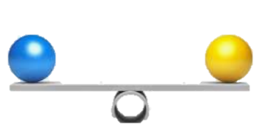

Slide 20
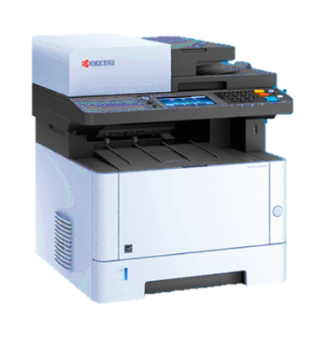

Slide 21
Learning Objectives
Explain and interpret the Accounting Equation

Slide 22
Inventory refers to goods that a trading business buys for resale.

Slide 23
Revenue are amount earned from the selling goods or providing a service.
Amount earned from selling inventory is called Sales Revenue.
Expense are cost used to earn the revenue.
Eg, rent expense
Cost of inventory sold is called Cost of Sales and is
an Expense

Slide 24
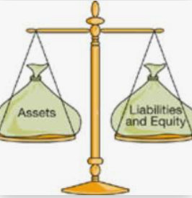
“on credit” means pay later.
A liability is created.

Slide 25
sold “on credit” means we received cash later.
A asset is created.

Slide 29
Learning Objectives
Prepare the financial statements.

Slide 30
Financial Statements
Let’s prepare the financial statements reflecting the transactions we have recorded.
Statement of Profit or Loss
Statement of Financial Position

Slide 31
Statement of Profit or Loss
The Statement of Profit or Loss shows a company’s revenues and expenses with the resulting net profit or loss over a period of time.

Slide 32
Statement of Financial Position
The Statement of Financial Position shows a company’s financial position at a point in time.

Slide 33

END OF CHAPTER 01

Slide 34
Summary of the chapter 1
Explain the importance of Accounting.
The functions of accounting involve analyzing, recording, classifying, summarizing, reporting, and interpreting financial information.
Forms of business organization:
A sole proprietorship is a business owned by one person.
A partnership is a business owned by two or more persons.
A company is a business owned by shareholders.

Slide 35
Summary of the chapter
Explain the basic Accounting Equation.
Assets = Liabilities + Equity
Assets are resources owned by business.
Liabilities represent amounts owed to external parties.
Equity represent owners claims on the assets
Seeing how revenue, expenses, expand the basic accounting equation.
Revenue are amount earned from sale of inventory.
Expenses are cost incurred to generate the revenue.

Slide 36
Summary of the chapter
Prepare the financial statements
- Statement of Profit or Loss is report
for a specific period of time
lists earned revenue and expenses incurred
NET PROFIT / NET LOSS
- Statement of Financial Position is report
for a specific point of time
the ending balances of assets and liabilities from the accounting equation and the ordinary shareholders plus the net profit

